Slide 1
Topic: Linear Relationships EQ – How do we use the gradient and y-intercept from a graph to form a linear equation?

Slide 2
24
7
30
Date: /9/2018
Linear Relationships
EQ – How do we use the gradient and y-intercept from a graph to form a linear equation?
25

Slide 3
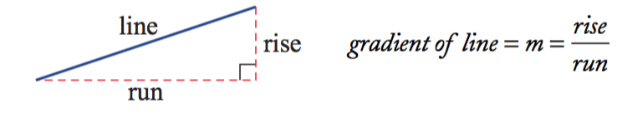
24
7
30
Date: /9/2018
Linear Relationships
EQ – How do we use the gradient and y-intercept from a graph to form a linear equation?
The gradient of a line is a measure of its slope.
What is gradient?
It is a number that shows the steepness of a line.
It is calculated by knowing how far a line rises or falls (called the rise) within a certain horizontal distance (called the run).
The gradient is equal to the rise divided by the run.
The letter m is used to represent gradient.
25

Slide 4
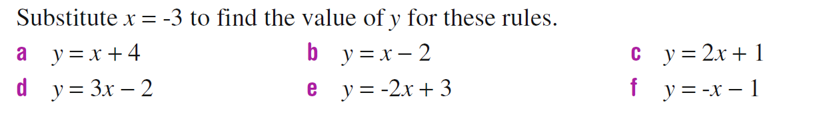
What’s the Value of Y?

Slide 5
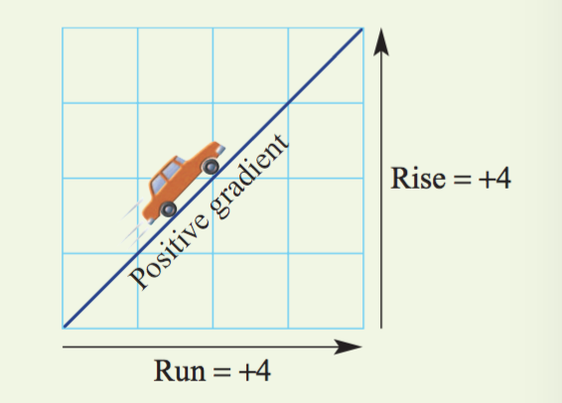
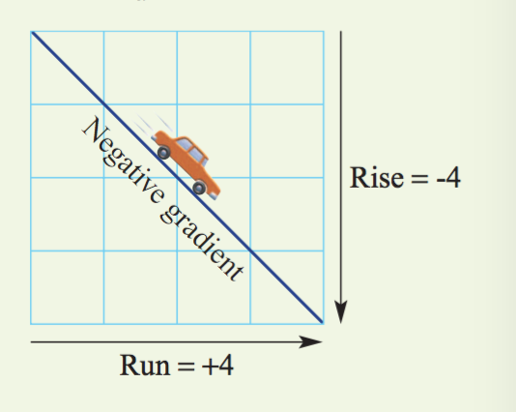
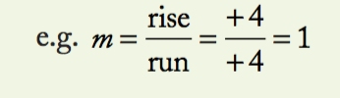
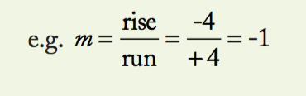
24
7
30
Date: /9/2018
Linear Relationships
EQ – How do we use the gradient and y-intercept from a graph to form a linear equation?
Important Note: Always move from left to right when considering the rise and the run.
If the line slopes up from left to right, the rise is positive and the gradient is positive.
If the line slopes down from left to right, the rise is considered to be negative and the gradient is negative.
25

Slide 6
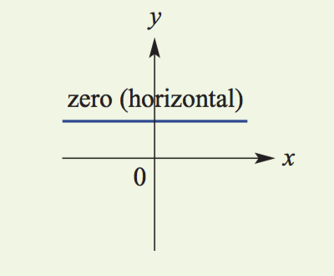
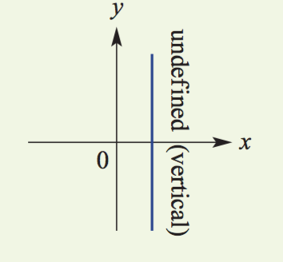
24
7
30
Date: /9/2018
Linear Relationships
EQ – How do we use the gradient and y-intercept from a graph to form a linear equation?
The gradient can also be zero (when a line is horizontal) and undefined (when a line is vertical).
25

Slide 7
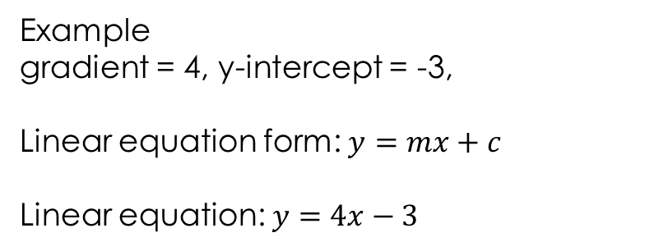
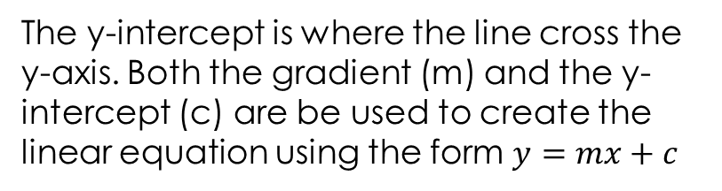
24
7
30
Date: /9/2018
Linear Relationships
EQ – How do we use the gradient and y-intercept from a graph to form a linear equation?
What is the y-intercept?
The y-intercept is where the line cross the y-axis. Both the gradient (m) and the y-intercept (c) are be used to create the linear equation using the form $y=mx+c$
Example
gradient = 4, y-intercept = -3,
Linear equation form: $y=mx+c$
Linear equation: $y=4x−3$
What is the point of intersection?
The intersection of linear graphs represents the values of the variables that fit both relationships
25

Slide 8
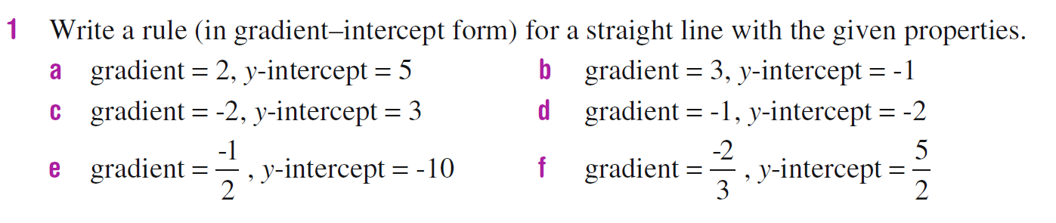
Task

Slide 9
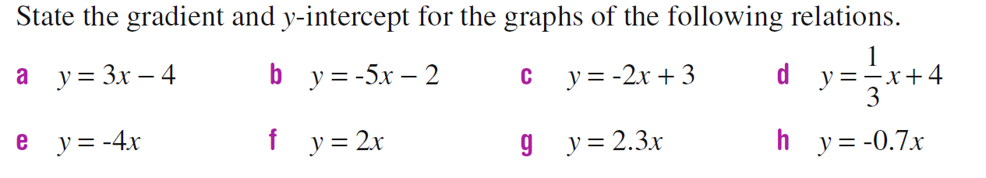
Task

Slide 10
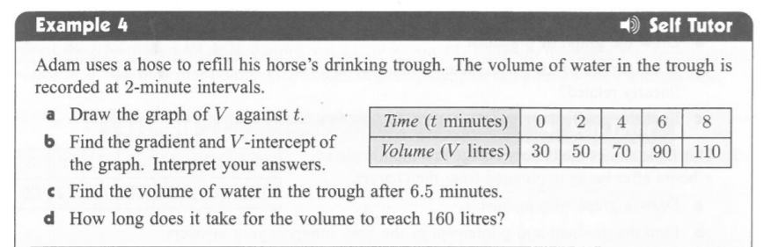
Let’s do together:

Slide 11
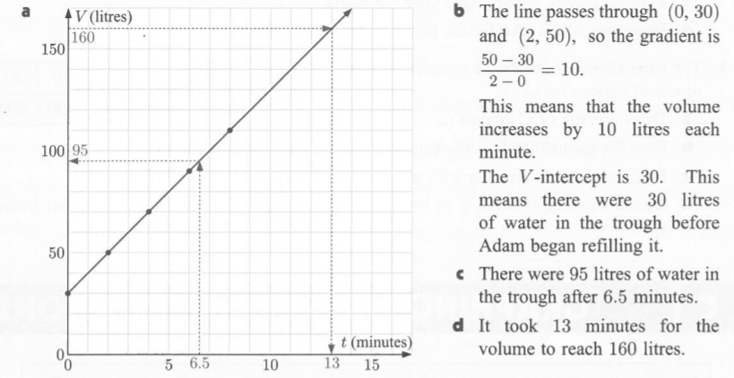
Let’s do together:

